Slide 1
Conflict MANAGEMENT
EMOTIONALI NTELLIGENCE
BULLYING PREVENTION
Anita Baloghová
processed course material

Slide 2
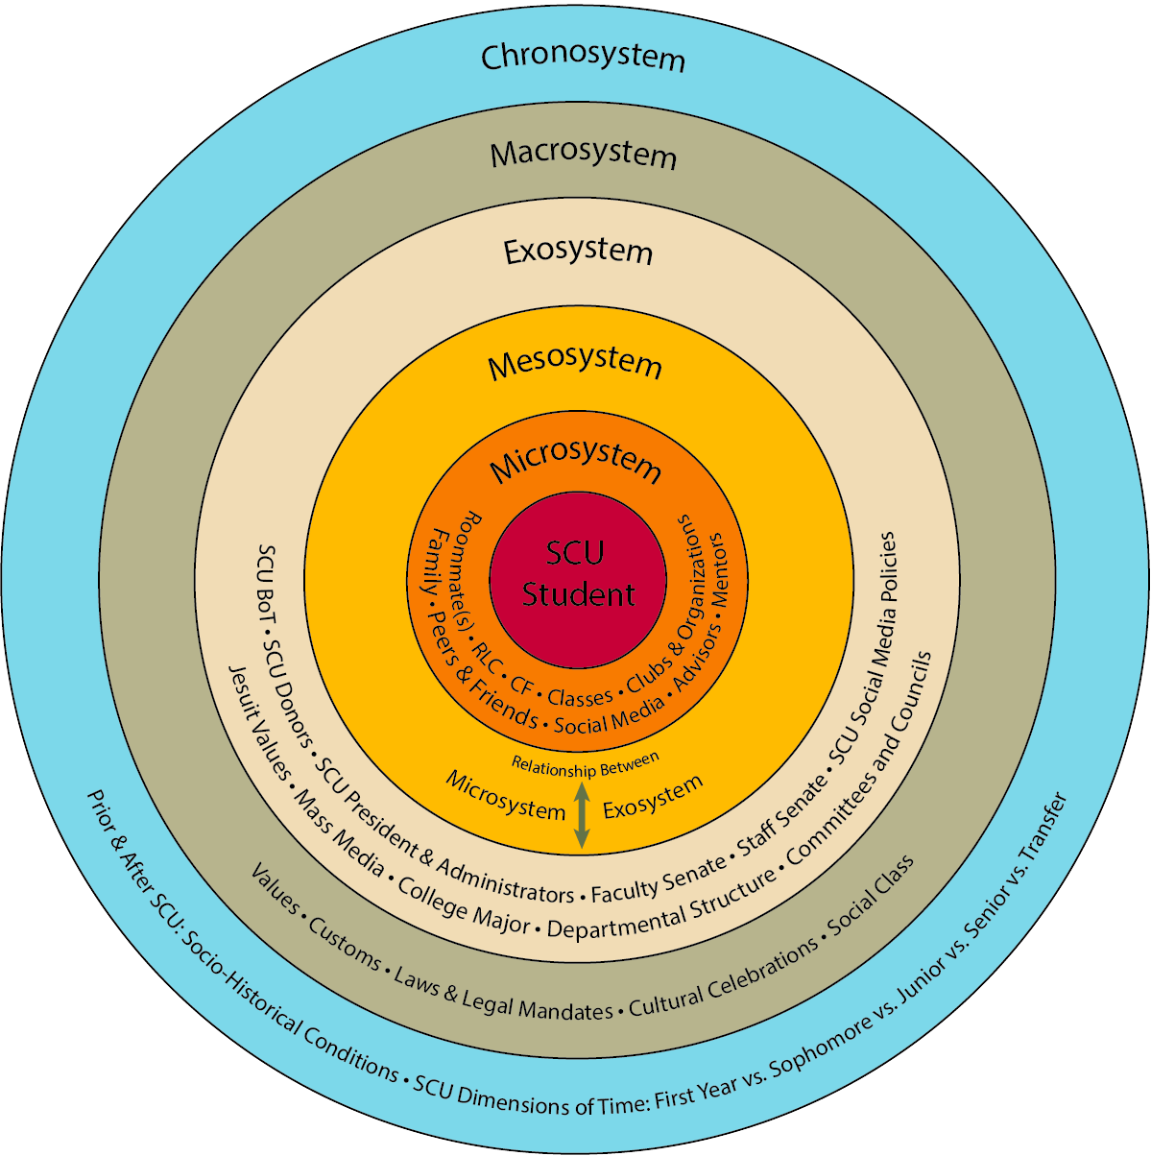
Bronfenbrenner’s Ecological Systems Theory

Slide 3
THE TRANSFORMATIONAL TEACHER
Albert Humphrey, 60-70s

Slide 4
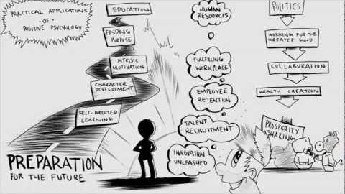
WHAT IS POSITIVE PSYCHOLOGY?

Slide 5
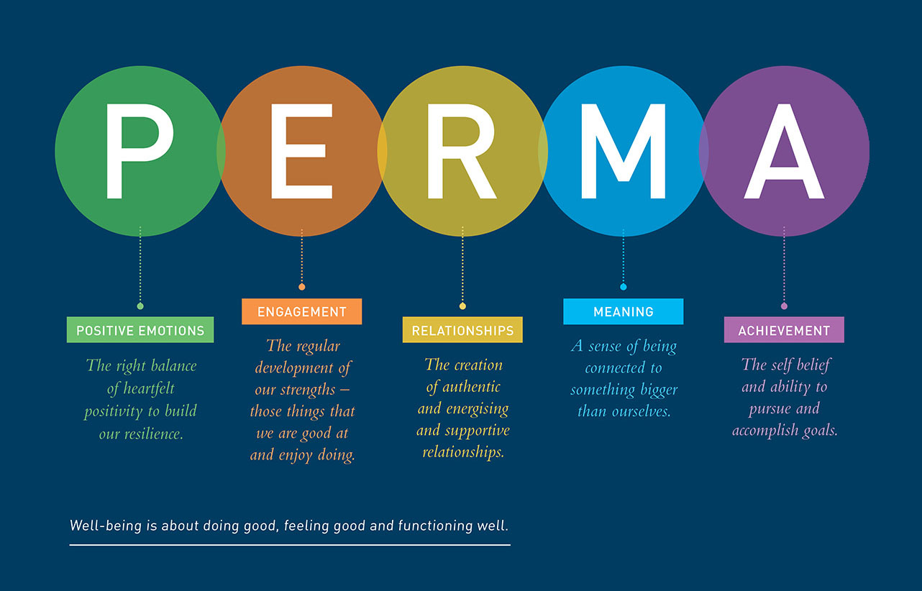
The PERMA Model of Well Being

Slide 6
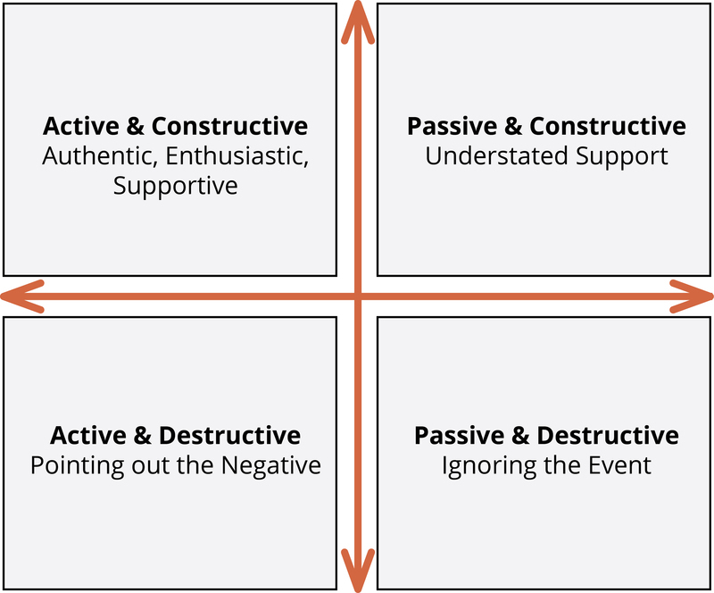
Active Constructive responding Model (Gable, Reis, Impett, & Asher, 2004).

Slide 7
What is conflict?
“Conflict is the process which begins when one party perceives that the other has frustrated, or is about to frustrate, some concern of his.”
K.W. Thomas
Conflict can be an expression of
  Hostility
  Antagonism
  Misunderstandings

Slide 8
Who can be in conflict at school?
Student vs. Student
Group of students vs. Individual student
Teacher vs. Student
Teacher vs. Teacher
Teachers vs. Administration/Management
Teachers vs. Families
Families vs. Families
Families vs. Administration

Slide 9
Conflict is inevitable… and often good!
It makes problems evident
Opens doors to change
Helps people to “be real”, authentic
Helps find benefits from diversity

Slide 10
But it can be a big problem…
Negative environment, fear, apathy, anger, distrust
Students learn less, teachers are stressed, families are worried
Encourages a vicious cycle of more CONFLICT

Slide 11
Sources of the conflict
Control over resources
Interdependent work; individual approaches
Differences in goals
Communication problems
Differences in perceptions and Values
Work environment, organization
Difference in personality and attitude
Unclear authority structures…. Etc

Slide 12
10 % of the conflicts are due to differences in opinion.
90% are due to wrong tone of voice.

Slide 13
Prejudices and Stereotypes may be behind conflicts
              A stereotype is “...a fixed, over generalized belief about a particular group or class of people.” (Cardwell, 1996)
Advantage:
it enables us to respond rapidly to (new) situations because we may have had a similar experience before/hear about it; it is comfortable
Disadvantage:
we generalize and that makes us ignore differences between individuals

Slide 14
Traditional gender stereotypes
Feminine
Not aggressive
Dependent
Easily influenced
Submissive
Passive
Home-oriented
Easily hurt emotionally
Indecisive
Talkative
gentle
Sensitive to other’s feelings
Very desirous of security
Cries a lot
Emotional
Verbal
Kind
Tactful
Nurturing
Masculine
aggressive
inDependent
Not Easily influenced
Dominant
Active
Worldly
Not Easily hurt emotionally
decisive
Not at all Talkative
Tough
Less Sensitive to other’s feelings
Not Very desirous of security
Rarely Cries
Logical
Analytical
Cruel
Blunt
Not Nurturing

Slide 15
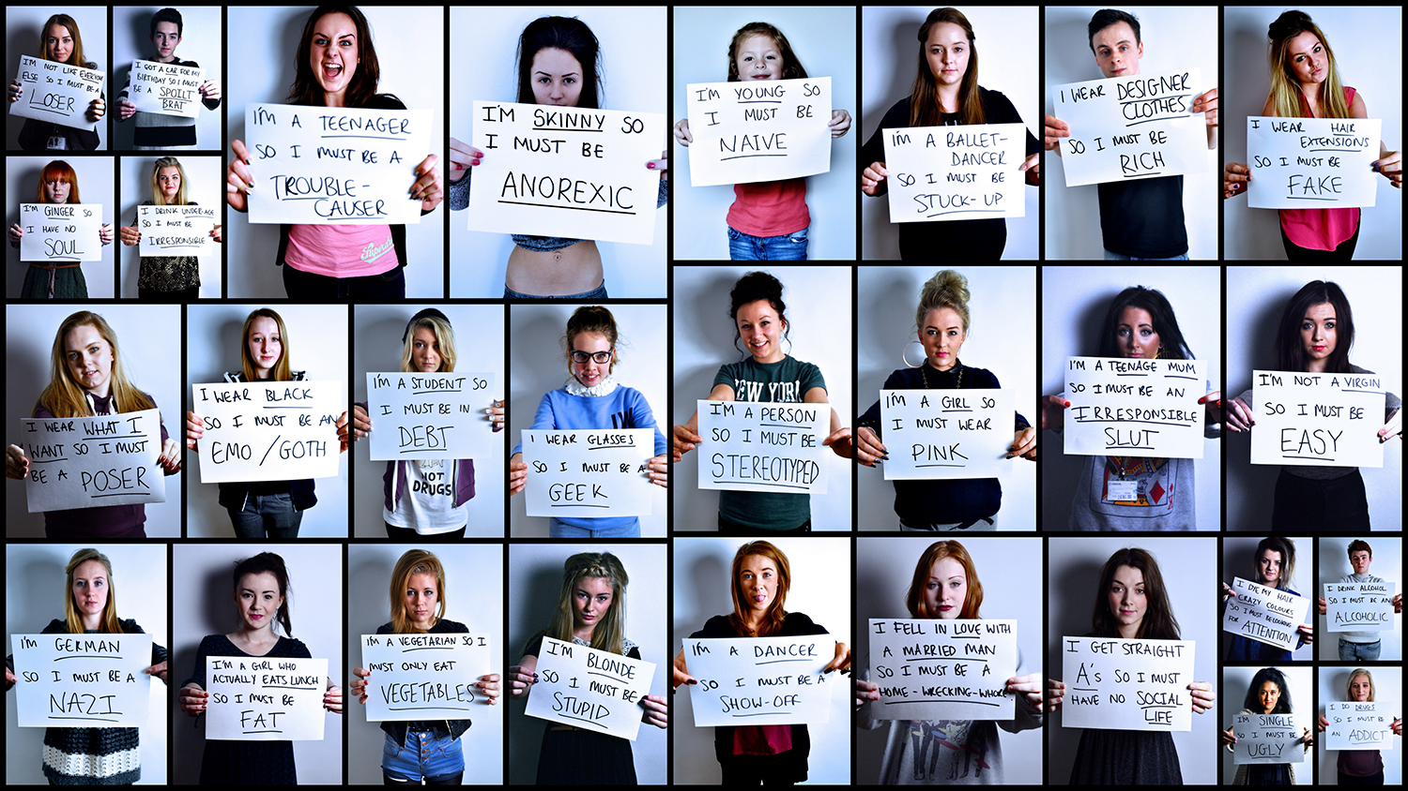

Slide 16
We can prevent conflicts in the school community:
1.having students reflecting on what a conflict IS
2. having students reflecting on what is THEIR RESPONSE TO A conflict WHEN they OBSERVE IT IN OTHERS OR WHEN THEY ARE IN A CONFLICT
3.NEUTRALISING THE SOURCE OF THE CONFLICT
4.workING on stereotypes
5. work to meet needs
6.work on gratitude, mindfulness

Slide 17
Conflicts often rise because of an unmet need
A. Maslow’s hierarchy of needs, 1943

Slide 18
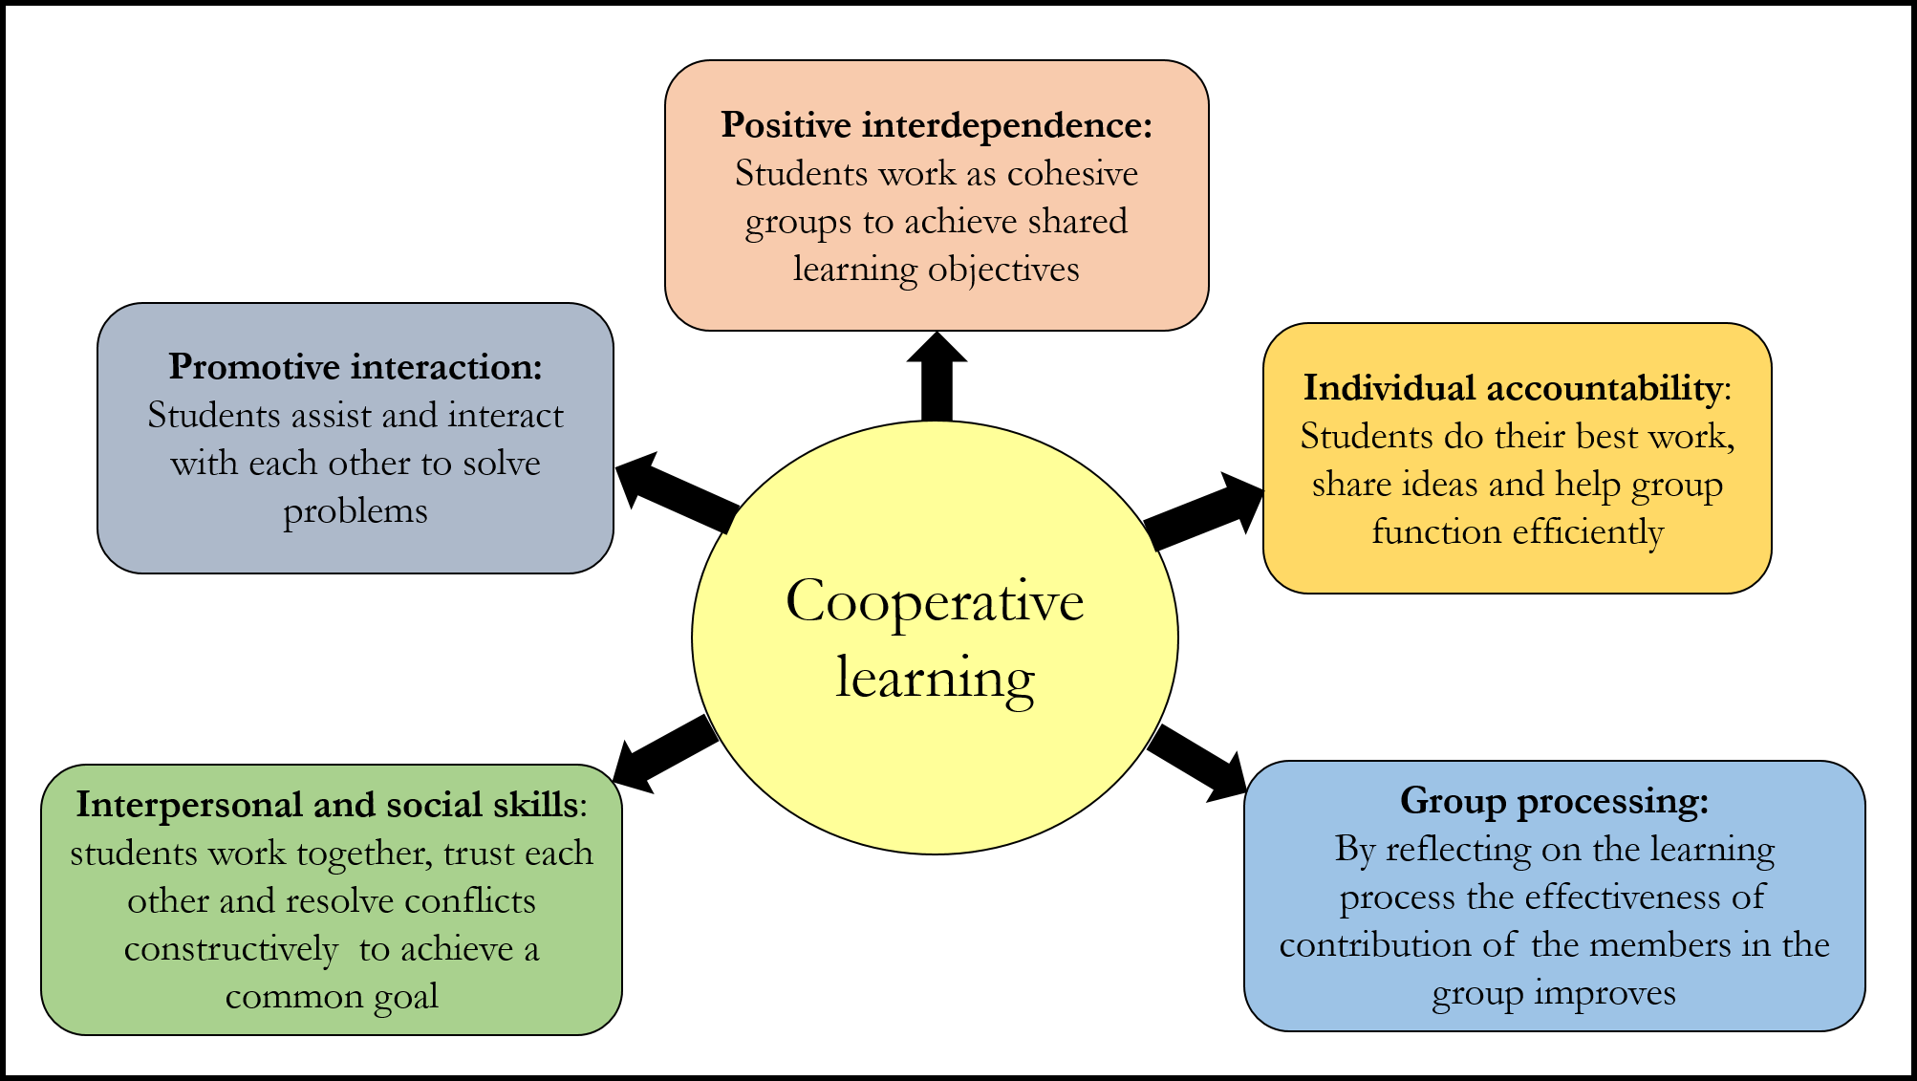
Cooperative Learning
Cooperative learning is a successful teaching strategy in which small teams, each with students of different levels of ability, use a variety of learning activities to improve their understanding of a subject.
Each member of a team is responsible not only for learning what is taught but also for helping teammates learn, thus creating an atmosphere of achievement.

Slide 19
The jigsaw method

Slide 20
Conflict management styles

Slide 21
Conflict Resolution – Some Basic Steps for Students AND TEACHER
Remain calm, step back and assess. Observe what is happening. Is it a really big deal? If not, let it go, walk away. If yes, proceed to the next steps.
Talk, compromise, resolve. Talk calmly about what has happened. If the people in the conflict are not able to calm down, do not try to reason with them. They aren’t ready, talk with them separately
FOR STUDENTS: Seek Peer mediator (if set in school) or an adult. A respected peer or an older student can help you discuss the problem and resolve it.
FOR TEACHERS: If you can’t solve it, seek other adult help, or counsellor, or headmaster

Slide 22
PEER MEDIATOR
A Peer Mediator is a trained third person (student in case of school) who leads the mediation in a conflict process and does not take sides.
Peer mediation needs at least six training session by professionals. Peer mediator are chosen accordingly to students and teachers disponibility, interest and ability.
A peer mediator is trained not to take sides in a conflict, not get involve in it.
Uses communication effectively with “I messages”.
Peer mediators may rotate during the school year/s and are supervised periodically.

Slide 23
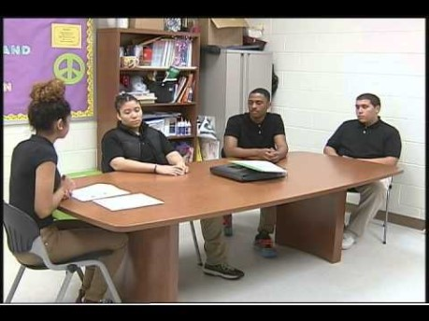
Peer mediation

Slide 24
I MESSAGE – I STATEMENT

Slide 26
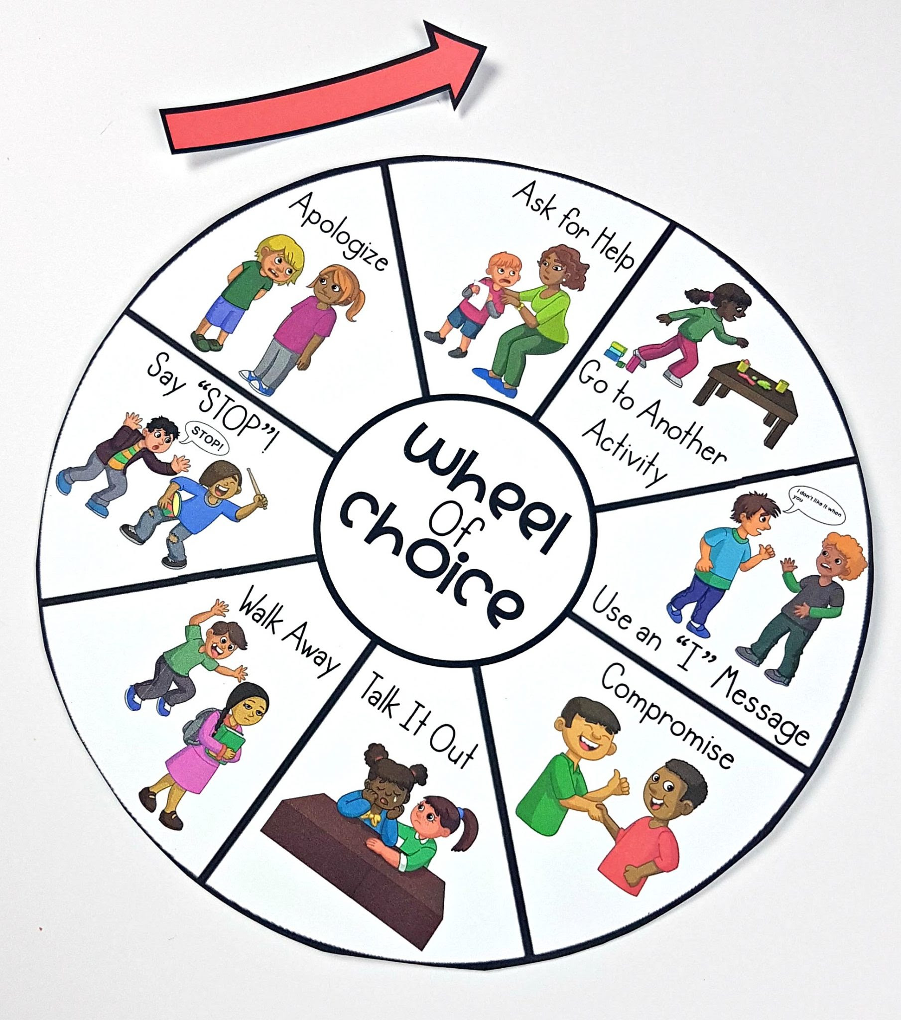

Slide 27
Emotional Literacy
Emotional Intelligence was first introduced by Daniel Goleman back in 1994.
His groundbreaking research theorised that humans are made up of different kinds of 'INTELLIGENCES'
Up until then, 'Intelligence' was equated with a high Intelligence Quotient, or IQ.
Goleman claimed that Emotional Intelligence, or EQ, was just as important as IQ, in creating highly functional, well-balanced people
Emotions can run wild in today's fast-changing world, so teaming up awareness of one's emotions with the rational ability to express them and use them constructively is a key competence for adults and children alike

Slide 28
How the brain processes strong emotion
Some emotional reactions create a sloppy response, for biological reasons.
The sensory thalamus receives the stimuli (spider) and sends signals.
The amygdala, specialist in emotional matters, receives the signal first and reacts immediately (yells).
The neo-cortex, able to think, deciphers the signal (it's just a spider).

Slide 29
High IQ does not equal High EQ
Emotion is crucial to effective thought, helping us make wise decisions and allowing us to “think clearly”.
A child with a high IQ who has poor impulse control may feel anxious, troubled, agitated. Up until then, 'Intelligence' was equated with a high Intelligence Quotient, or IQ.
That child is at risk for academic failure, even alcoholism and criminality because s/he has poor emotional control.

Slide 30
Emotions

Slide 31




Positive Emotions
GRATITUDE:
a feeling of thankfulness, for something specific or general, internal or external.
SERENITY:
a calm and peaceful feeling of acceptance of oneself and the environment.
INTEREST:
a feeling of curiosity or fascination about someone or something.
HOPE:
a feeling of optimism and anticipation about a positive future.

Slide 32




Positive Emotions
ENTHUSIASM:
excitement, accompanied by motivation and engagement.
OPTIMISM:
a positive and hopeful emotion that encourages you to look forward to a bright future.
LOVE:
feeling of deep and enduring affection for someone that can be an individual, a group of people, or even all humanity.
SATISFACTION:
a sense of pleasure and contentment you get from accomplishing something or fulfilling a need

Slide 33
3 components of Emotions
COGNITIVE COMPONENT
PHYSIOLOGICAL COMPONENT
BEHAVIOURAL COMPONENT
The expression of an emotion might be intensified, hidden, decreased, depending on the situation / environment (DISPLAY RULES)

Slide 34
Emotional intelligence

Slide 35
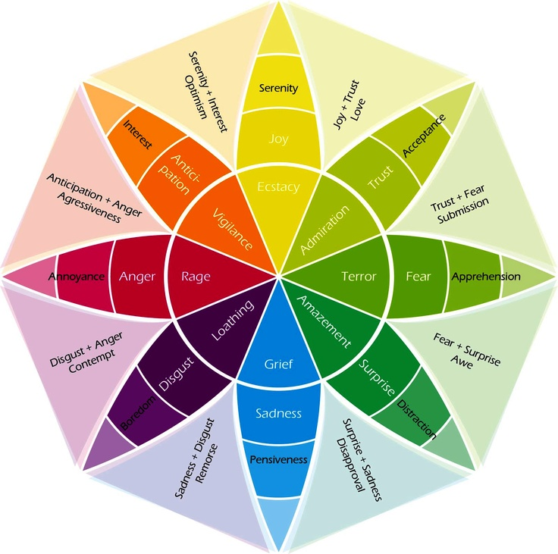
Robert plutchik - Wheel of emotions

Slide 36
Social and Emotional Intelligence Ingredients

Slide 37
The Emotional ABCs
For Goleman and many researchers and educators, children need to learn about their emotions and how they can help or hinder their Intellectual progress
Intellect cannot work best without Emotional Intelligence
Just like human languages, the emotional language needs to be comprehended, translated
“Feelings are typically indispensable to rational decisions; they point us in the proper direction.” D. Goleman

